Slide 1

CENG 789 – Digital Geometry Processing
13- Main Tasks in a Nutshell
Assoc. Prof. Yusuf Sahillioğlu
Computer Eng. Dept, , Turkey

Slide 2
Shape/Mesh Processing Tasks
<number> / 40
Already covered some important tasks (check out previous lectures).
  Shape descriptors, generation, reconstruction, registration.
  Mesh deformation, parameterization, remeshing, repairing.
Talk about some other prominent tasks today.
  Shape segmentation.
  Shape representation/approximation.
  Shape correspondence.
  Shape retrieval.
  Groupwise alignment.
  Human-centric shape analysis (indirect).
  Shape interpolation/morphing.
  Scene synthesis and labeling.
  Slides in the sequel represent Potential Project Topics.

Slide 3

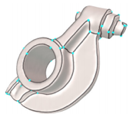
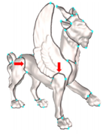
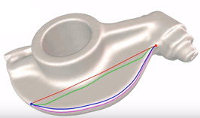
Shape Segmentation
<number> / 40
User-guided shape segmentation.
  Live-wire interaction (well-known in image processing).
  https://www.youtube.com/watch?v=XRj8AFlkZfY

Slide 4
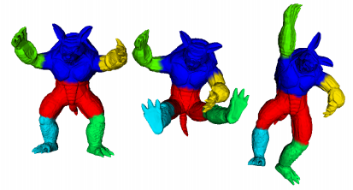
Shape Segmentation
<number> / 40
Fully-automatic shape segmentation.
Shape representation: MDS.
Followed by k-means clustering algorithm.

Slide 5
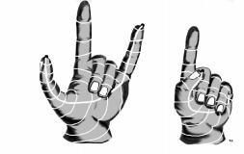

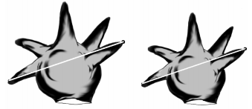
Shape Segmentation
<number> / 40
Fully-automatic shape segmentation.
Shape representation: MDS (bending-invariant).

Slide 6
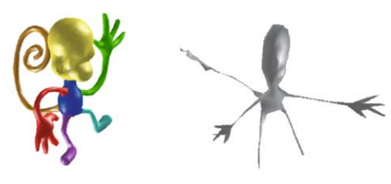
Shape Segmentation
<number> / 40
Fully-automatic shape segmentation.
Shape representation: MDS (bending-invariant).

Slide 7
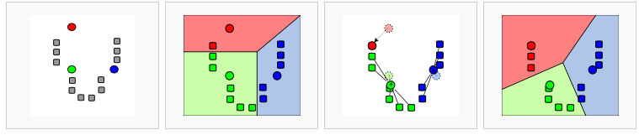
Shape Segmentation
<number> / 40
Fully-automatic shape segmentation.
K-means clustering.

Slide 8
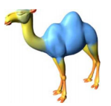
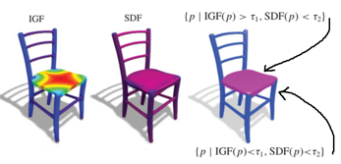

Shape Segmentation
<number> / 40
Fully-automatic shape segmentation.
More sophisticated data-driven segmentation methods exist.
  Hierarchical decomposition.
  Randomized cuts.
  Core extraction.
  Fitting primitives.
  Shape diameter function (SDF).
  Intrinsic girth function (IGF).
Notes:
For a point p on the surface, the value of the IGF at p is the length of the shortest nonzero geodesic path starting and ending at p. The IGF is invariant under isometry, insensitive to mesh tessellations, and robust to surface noise.

Slide 9
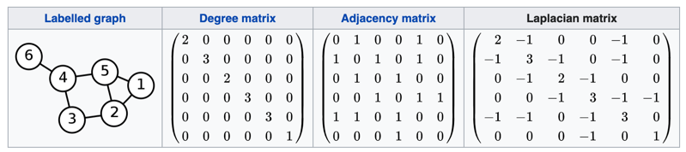


Shape Segmentation
<number> / 40
Fully-automatic shape segmentation via spectral clustering.
Spectrum (eigvals) of a matrix, the Laplacian Matrix = Degree – Adj.
Lx = 0 for all const vectors, e.g., x=[1 1 .. 1]^{T}. Eigval = 0, eigvec = c.
2nd smallest eigval is more useful; it comes with the Fiedler eigenvector.
This eigval/vec, call it x2, approximates the sparsest cut of a graph.
  Eigvecs orthogonal: x1 is constant, so to make dot prodct 0, x2 has +ve and –ve components. These 2 sets of components are clusters.
Not directly applicable to Mesh Segmentation as mesh graph is regular.

Slide 10
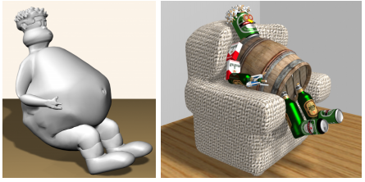
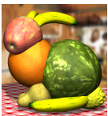
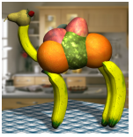
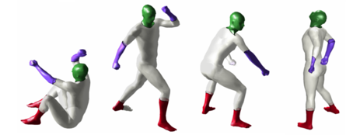
Shape Segmentation
<number> / 40
Why segment? Once you have the parts, you can go wild, e.g., collage
Collection understanding through part-level correspondences, ..

Slide 11
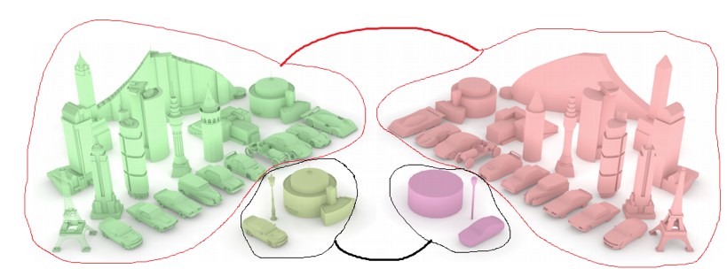
Shape Approximation
<number> / 40
Computing simple geometric descriptions for dense surfaces.
  Mesh decimation (minimal elements; already covered).
  Mesh decimation based on context. See https://youtu.be/62_1CQirnzM

Slide 12
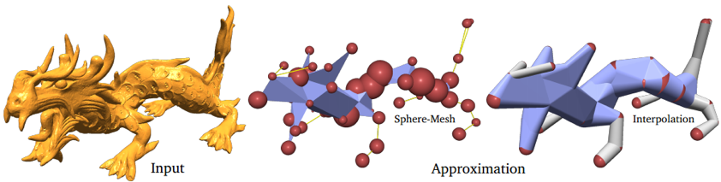
Shape Approximation
<number> / 40
Computing simple geometric descriptions for dense surfaces.
  Mesh decimation (minimal elements; already covered).
  Mesh decimation based on volume.
    At extreme simplification levels, model the volumetric extent of the original shape. See https://youtu.be/Jz09SAeBWI0

Slide 13
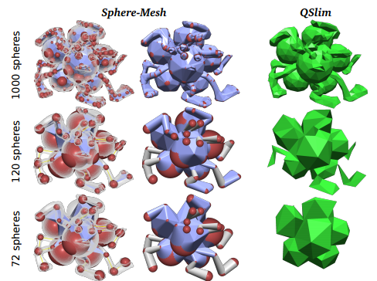
Shape Approximation
<number> / 40
Computing simple geometric descriptions for dense surfaces.
  Mesh decimation (minimal elements; already covered).
  Mesh decimation based on volume.
    Sphere interpolation replacing classic point interpolation.

Slide 14
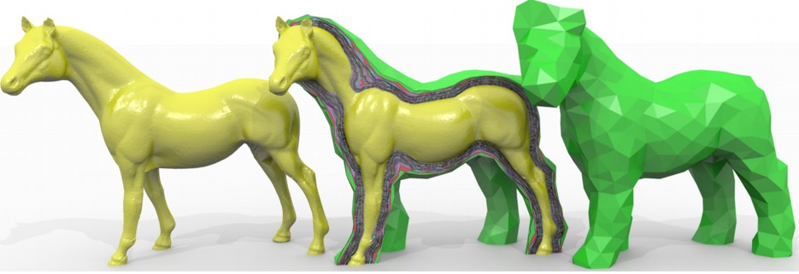
Shape Approximation
<number> / 40
Computing simple geometric descriptions for dense surfaces.
  Mesh decimation (minimal elements; already covered).
  Mesh decimation based on level.
    Nested cages for faster collision detection and deformation.

Slide 15
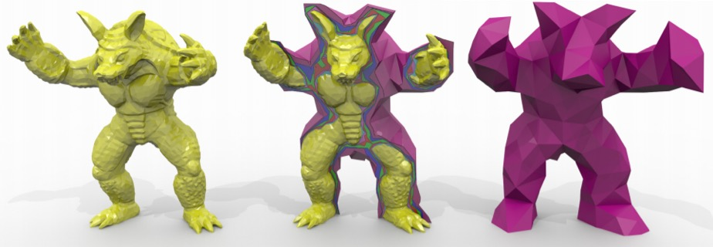
Shape Approximation
<number> / 40
Computing simple geometric descriptions for dense surfaces.
  Mesh decimation (minimal elements; already covered).
  Mesh decimation based on level.
    Nested cages. Shrink, re-inflate. See https://youtu.be/tTEGDPHv_AI
Notes:
Better than using the decimated model as the cage because decimated is likely to penetrate inside the actual model, which fails collision detection (and maby deformation).

Slide 16
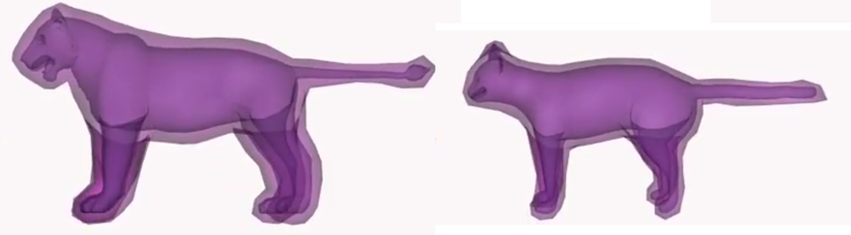
Shape Approximation
<number> / 40
Computing simple geometric descriptions for dense surfaces.
  Mesh decimation (minimal elements; already covered).
  Mesh decimation based on level.
    Nested cages. Shrink, re-inflate. See https://youtu.be/tTEGDPHv_AI
    Cage-based deformations. Read
      Spatial Deformation Transfer. https://youtu.be/ayeKItDliUc
      Embedded Deformation. https://youtu.be/BEEN7Dmo9vI

Slide 17
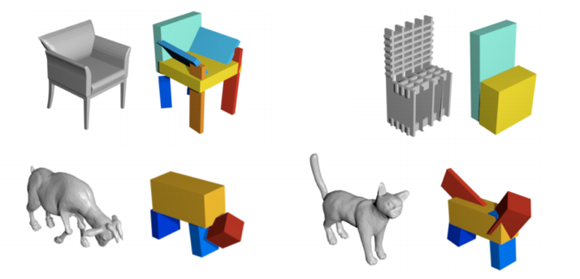
Shape Approximation
<number> / 40
Computing simple geometric descriptions for dense surfaces.
  Assemble of volumetric primitives.

Slide 18
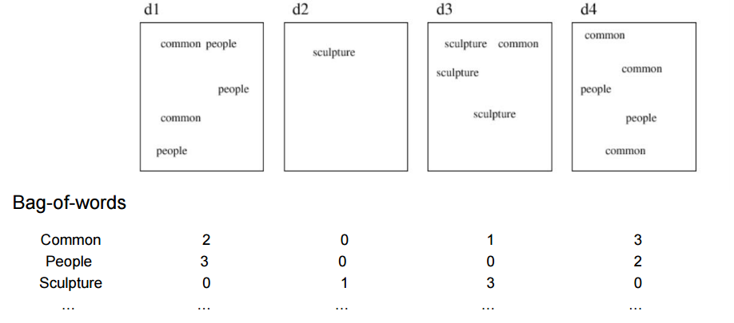
Shape Representation
<number> / 40
Computing simple geometric descriptions for dense surfaces.
  Bag-of-words (bag-of-features) shape representation.

Slide 19
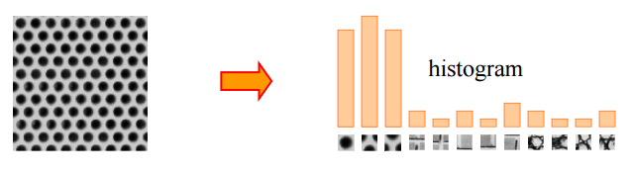
Shape Representation
<number> / 40
Computing simple geometric descriptions for dense surfaces.
  Bag-of-words (bag-of-features) shape representation.
  Need a visual vocabulary for shape (not text) processing.

Slide 20
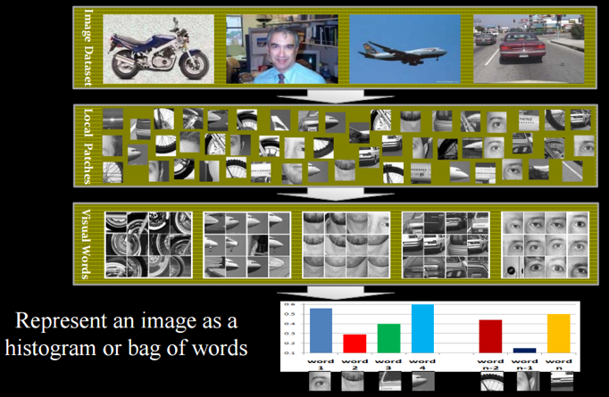
Shape Representation
<number> / 40
Computing simple geometric descriptions for dense surfaces.
  Bag-of-words (bag-of-features) shape representation.

Slide 21
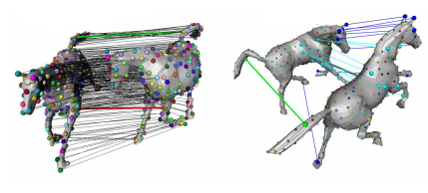
Shape Correspondence
<number> / 40
Define a map-distortion function that quantifies how good a given map is.
Combinatorial search on space of maps.
  Use the map minimizing the distortion function.

Slide 22
Shape Correspondence
<number> / 40
Define a map-distortion function that quantifies how good a given map is. Many variants in the literature; see
  Coarse-to-Fine Combinatorial Matching For Dense Isometric Shape Correspondence (C2FCM)
  Scale Normalization for Isometric Shape Matching
  Non-rigid registration under isometric deformations
  Blended intrinsic maps
  Generalized multidimensional scaling
Cast the problem as matching between function values, not points: Functional Maps (not covered here).
  By the author: https://youtu.be/l9pqyo85nFE?t=884
  A good function. Laplace-Beltrami eigenfunctions: https://youtu.be/CpdJVcXQte4?t=502

Slide 23

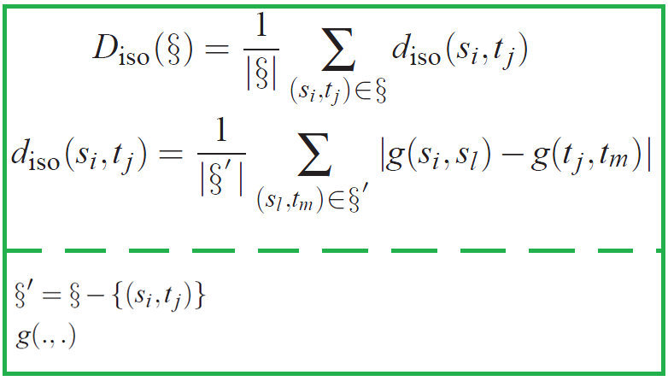
Isometric Distortion
<number> / 40
Given , measure its isometric distortion (from C2FCM):
in the most general setting.
: normalized geodesic distance b/w two vertices.
O(N²) for a map of size N.

Slide 24

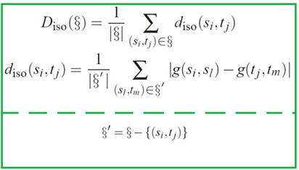





Isometric Distortion Illustration
<number> / 40
g
g
g
g
g
in action:
g
g
g
average for .

Slide 25
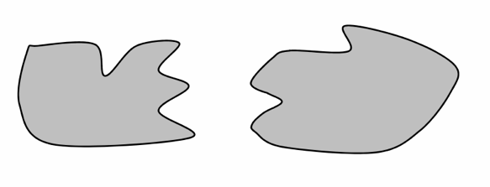
Shape Correspondence
<number> / 40
Well-studied for isolated pair of X shapes.
X =
  Isometric or non-rigid
  Rigid
  Non-isometric
At its infancy for collection analysis.
  Use context info to improve results.

Slide 26
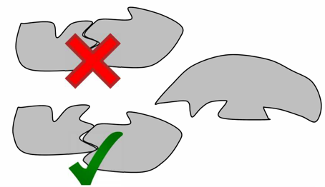
Shape Correspondence
<number> / 40
Well-studied for isolated pair of X shapes.
X =
  Isometric or non-rigid
  Rigid
  Non-isometric
At its infancy for collection analysis.

Slide 27
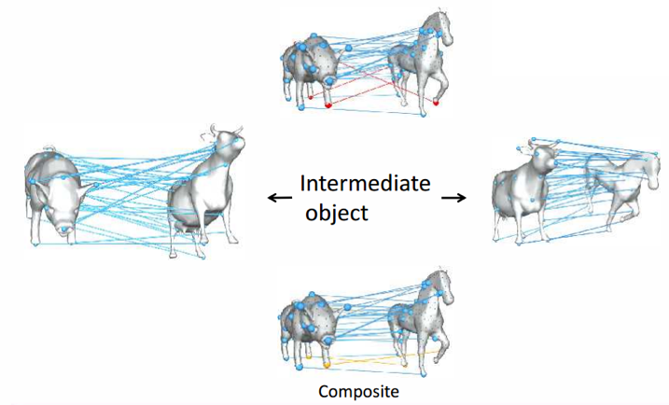
Shape Correspondence
<number> / 40
At its infancy for collection analysis.
Replace a (bad) map w/ a composition of (better) maps.
= w/ a composition of maps on the shortest/best path b/w 2 shapes.

Slide 28
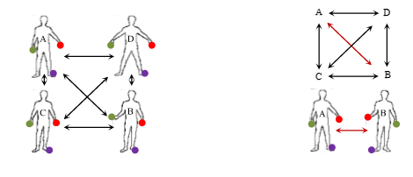
Shape Correspondence
<number> / 40
At its infancy for collection analysis.
Consistent (left) vs. inconsistent (right) maps.
Read
  An optimization approach to improving collections of shape maps
  Multiple shape correspondence by dynamic programming

Slide 29
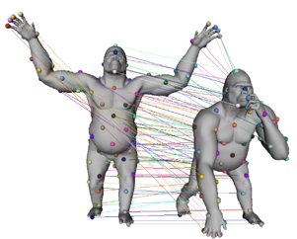
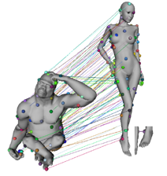
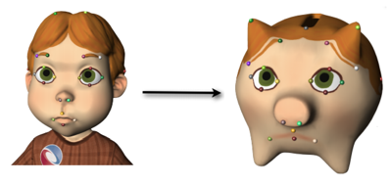
Shape Correspondence
<number> / 40
Non-isometric case harder due to stretching.
vs.
Idea: Interpolate a few predefined correspondences on landmarks
  Weighted averages on surfaces. See https://youtu.be/tlMsB6tBO2w

Slide 30
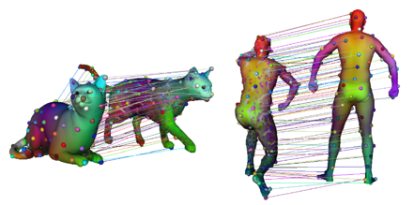
Shape Correspondence
<number> / 40
Non-isometric case harder due to stretching.
vs.
Idea: Interpolate a few predefined correspondences on landmarks
  Blended intrinsic maps.
  Non-smooth blend:

Slide 31
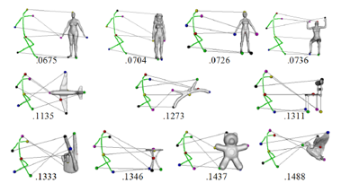
Shape Retrieval
<number> / 40
Query-by-text.
  Google search.
  Shape adaptation: DB needs to be manually tagged ☹
Query-by-example.
  Shape adaptation: User provides a 3D model; popular but hard to come up with a 3D model ☹.
Query-by-sketch.
  Shape adaptation: User simply draws; easy for user but not so accurate due to view and drawing differences ☹.
  Articulated:

Slide 32
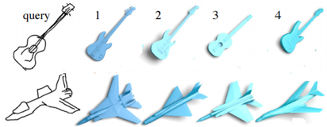
Shape Retrieval
<number> / 40
Query-by-text.
  Google search.
  Shape adaptation: DB needs to be manually tagged ☹
Query-by-example.
  Shape adaptation: User provides a 3D model; popular but hard to come up with a 3D model ☹.
Query-by-sketch.
  Shape adaptation: User simply draws; easy for user but not so accurate due to view and drawing differences ☹.
  Non-articulated: See https://youtu.be/lVszERiVaJI

Slide 33
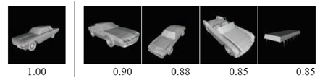
Shape Retrieval
<number> / 40
Index database models with
  Features.
  Bending-invariant representations.
  Bag-of-words.
  ..
Convert to query model into that index.
  Retrieve the most compatible model according to the indexing.

Slide 34
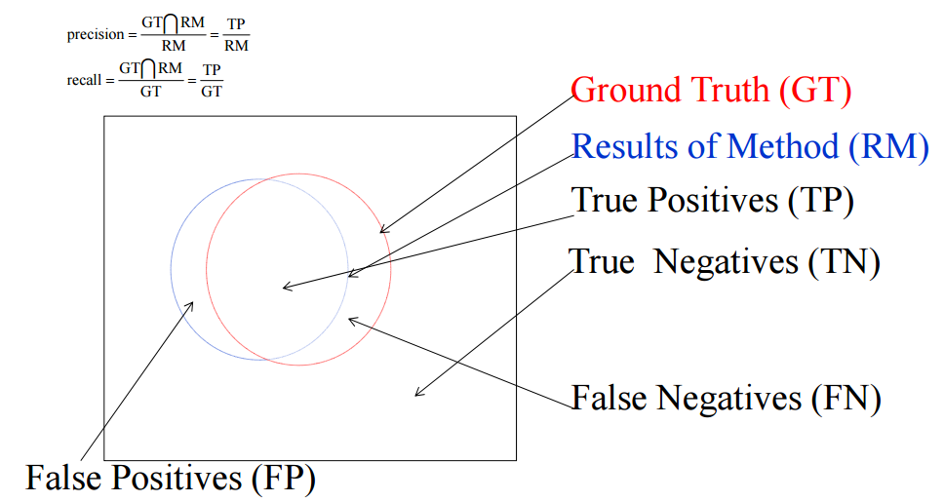
Shape Retrieval
<number> / 40
Evaluation of shape retrieval performance.
Precision-recall plots.

Slide 35
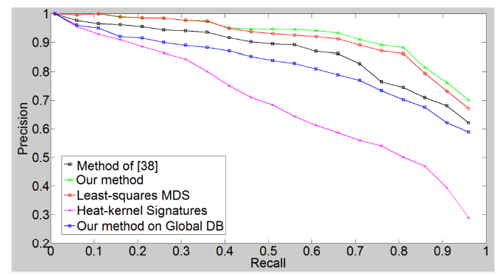
Shape Retrieval
<number> / 40
Evaluation of shape retrieval performance.
Precision-recall plots.
  Ideally this curve should be a horizontal line at unit precision.

Slide 36
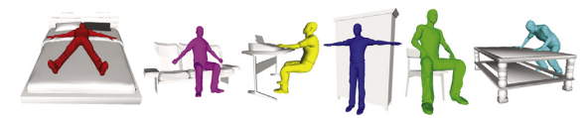
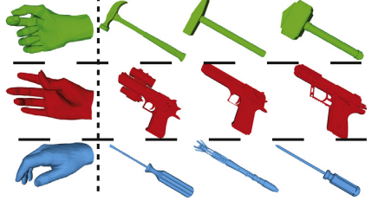
Human-centric Shape Analysis
<number> / 40
Recognize/classify/segment objects based on their interaction with human agents.
  Human body.
  Human hand.
  ..

Slide 37
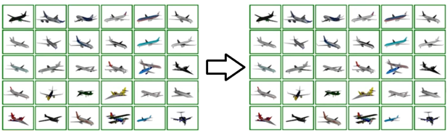
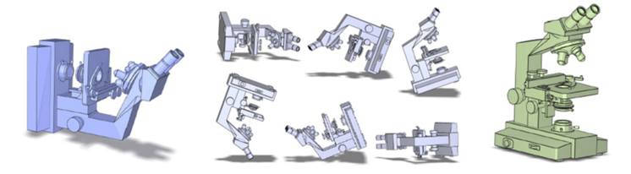
Groupwise Shape Alignment
<number> / 40
Make every shape in collection look right.
  See https://youtu.be/m584yqGtlCE
Put every shape in collection in upright orientation.
  See https://youtu.be/j5BS2XL9304

Slide 38
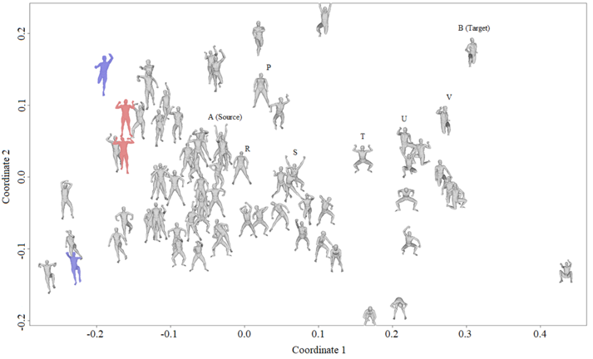
Shape Interpolation
<number> / 40
Instead of interpolating directly from A to B, create a path of shapes in data-driven fashion: A→R→S→T→U→V. Connecting more similar shapes along the path is bound to give better results.

Slide 39
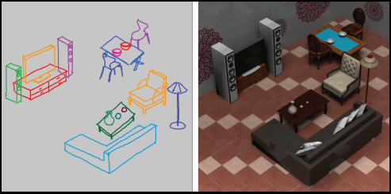
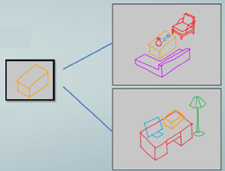
Scene Synthesis
<number> / 40
An intuitive approach is to keep the user in the loop via sketches.

Slide 40
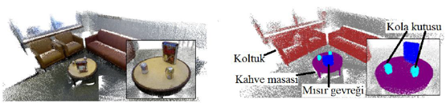
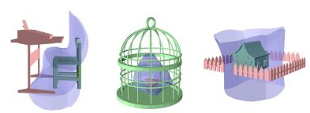

Scene Segmentation and Labeling
<number> / 40
In order to issue this command to a robot: Get me the mug on table, need segmentation & labels on scene point cloud (acquired by a depth sensor).
User guidance might help for segmentation: https://youtu.be/z_TcWC7yjj0
Pairwise analysis might help for labeling.

